Slide 1
Operation Analytics and Investigating Metric Spike
(Project – 3)
- BY HITISHA SONI

Slide 2
Project Description :-
Operational Analytics is a crucial process that involves analyzing a company's end-to-end operations.
This analysis helps identify areas for improvement within the company.
As a Data Analyst, you'll work closely with various teams, such as operations, support, and marketing, helping them derive valuable insights from the data they collect.
One of the key aspects of Operational Analytics is investigating metric spikes.
This involves understanding and explaining sudden changes in key metrics, such as a dip in daily user engagement or a drop in sales.
As a Data Analyst, you'll need to answer these questions daily, making it crucial to understand how to investigate these metric spikes.

Slide 3
Approach :-
In this project, as we are working as the role of a Lead Data Analyst at a company like Microsoft
We have few tables containing data relevant to the platform.
We have,
1 table:- job_data for case study 1
3 tables: users, events, email_events for case study 2
By these tables we can give provide valuable insights that can help improve the company's operations and understand sudden changes in key metrics.
1
Job_data
2
users
2
events
2
email_events
Tables:

Slide 4
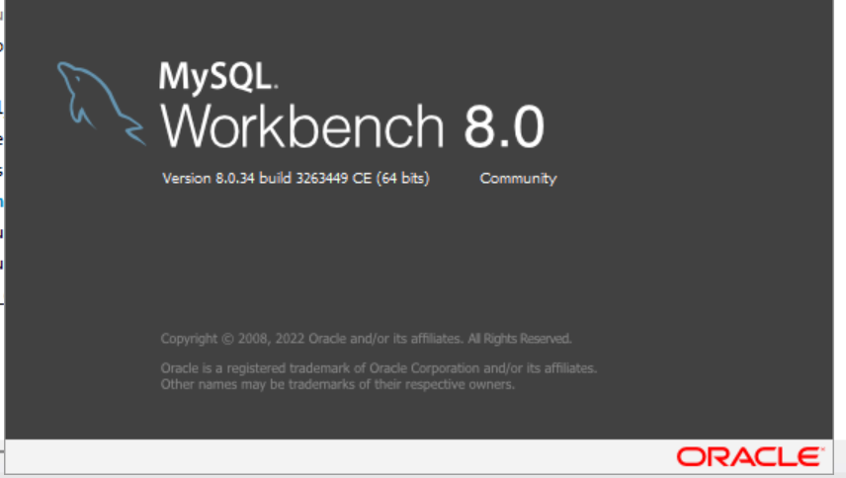
Tech-Stack Used:-
I used MySQL Workbench.
Version 8.0.34
Because it is very simple but effective tool to perform complex queries.
It has many features, it works as an IDE for SQL.

Slide 5
Case Study -1: Job Data Analysis

Slide 6
1. Jobs Reviewed Over Time : Calculate the number of jobs reviewed per hour for each day in November 2020.
Your Task: Write an SQL query to calculate the number of jobs reviewed per hour for each day in November 2020.

Slide 7
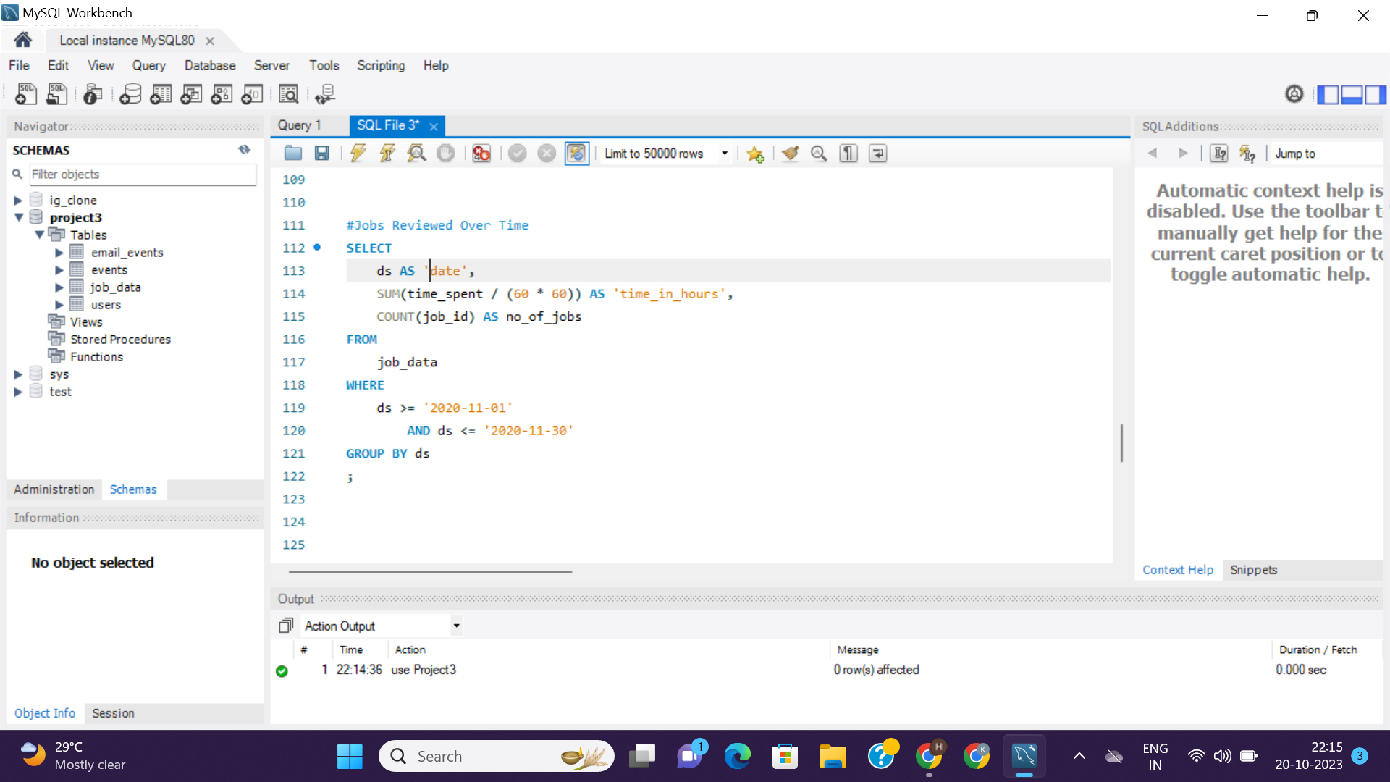
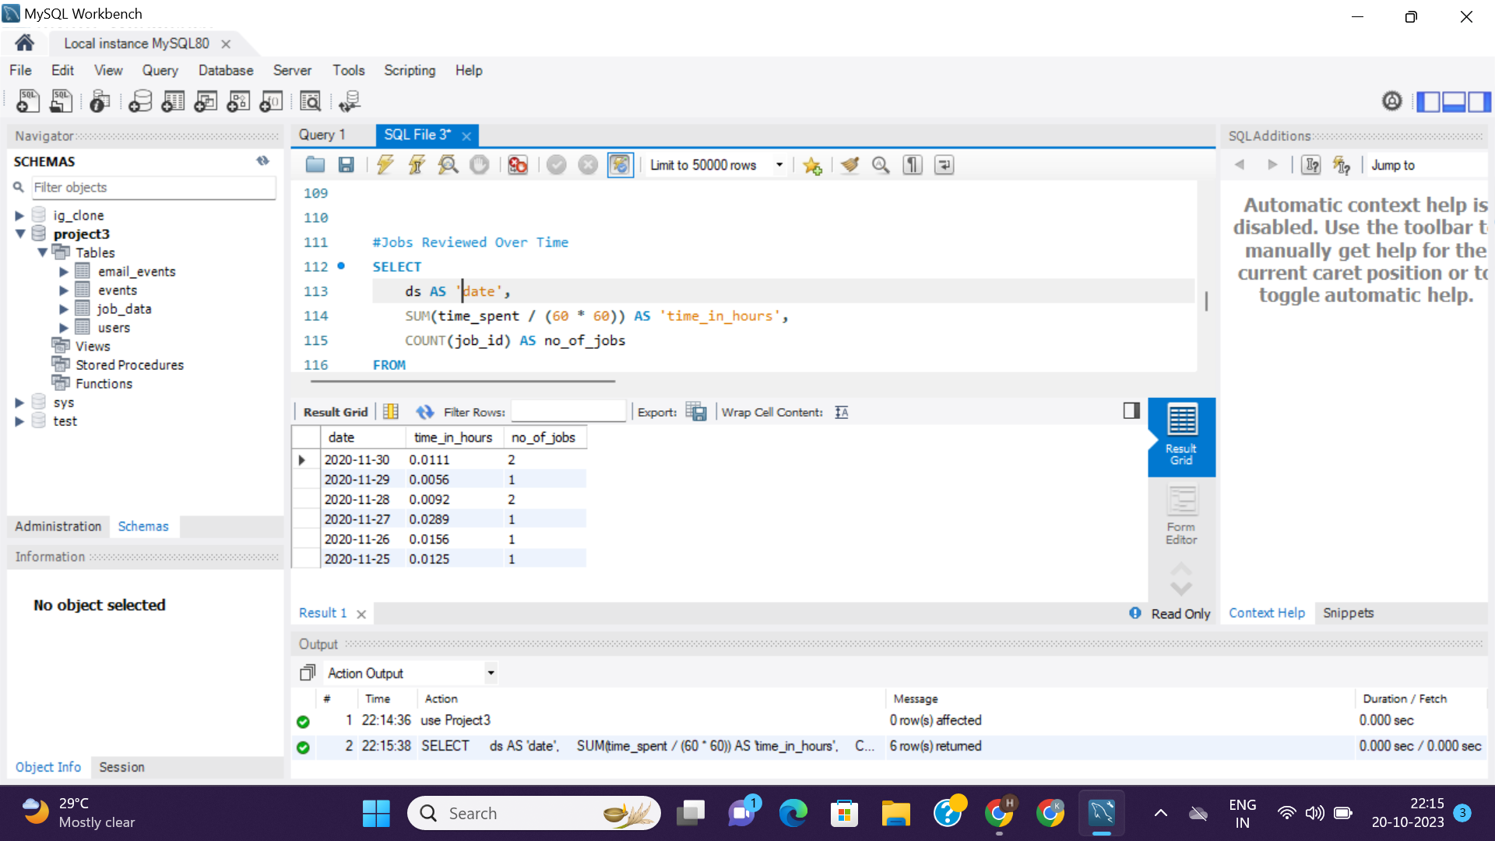
<= Query
Result =>

Slide 8
2. Throughput Analysis : Calculate the 7-day rolling average of throughput (number of events per second).
Your Task: Write an SQL query to calculate the 7-day rolling average of throughput.

Slide 9
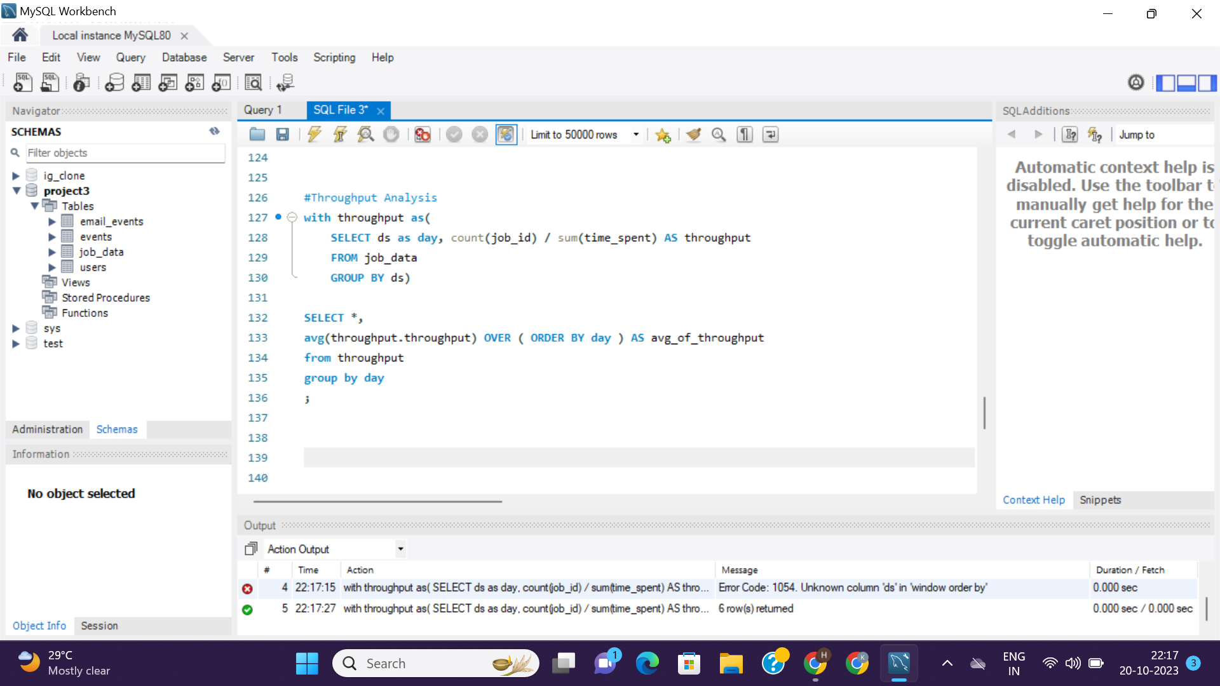
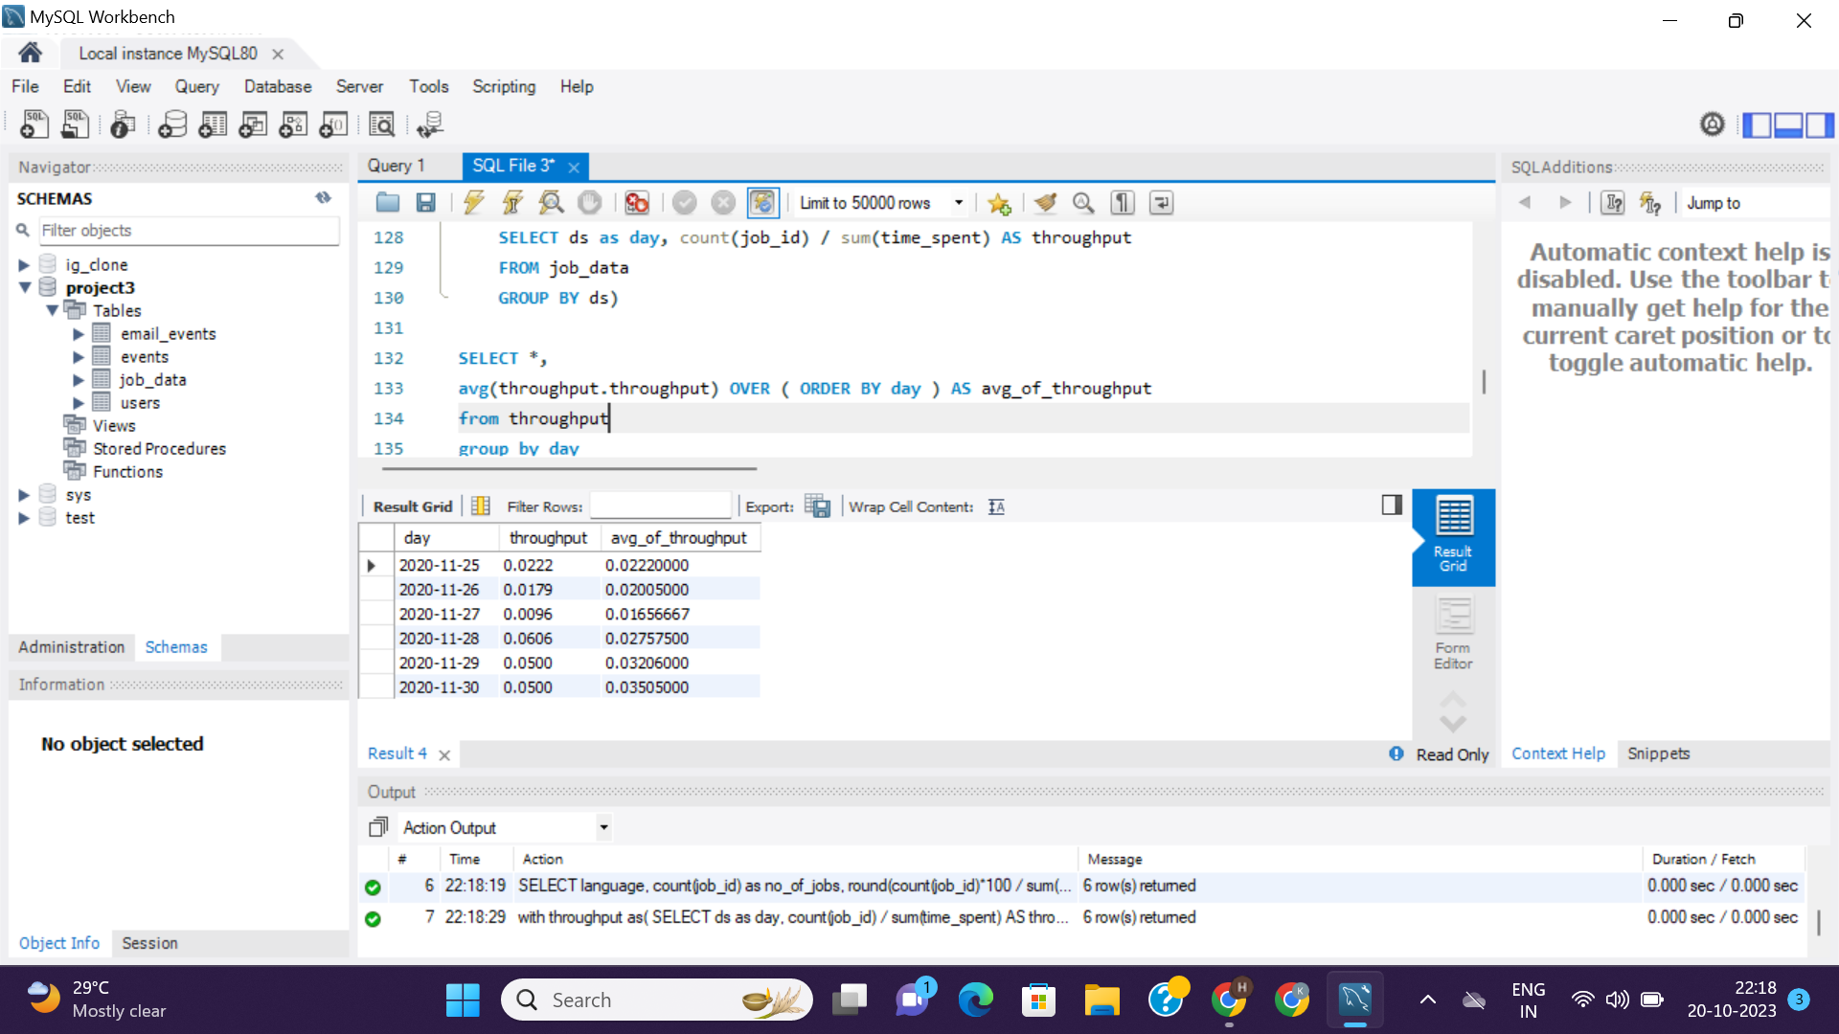
<= Query
Result =>

Slide 10
3. Language Share Analysis: Calculate the percentage share of each language in the last 30 days.
Your Task: Write an SQL query to calculate the percentage share of each language over the last 30 days.

Slide 11
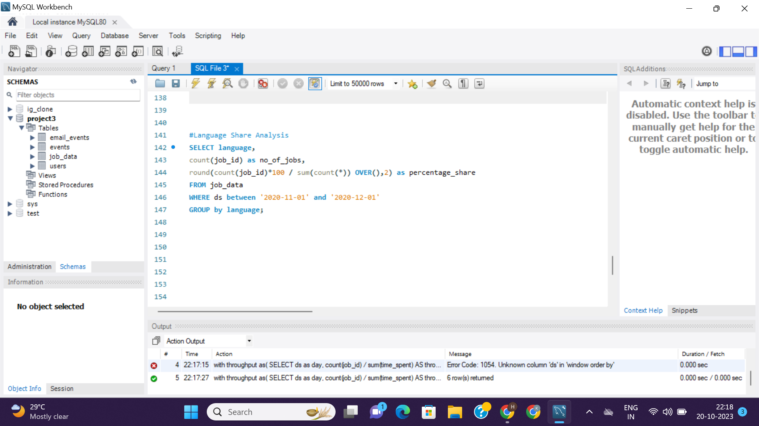
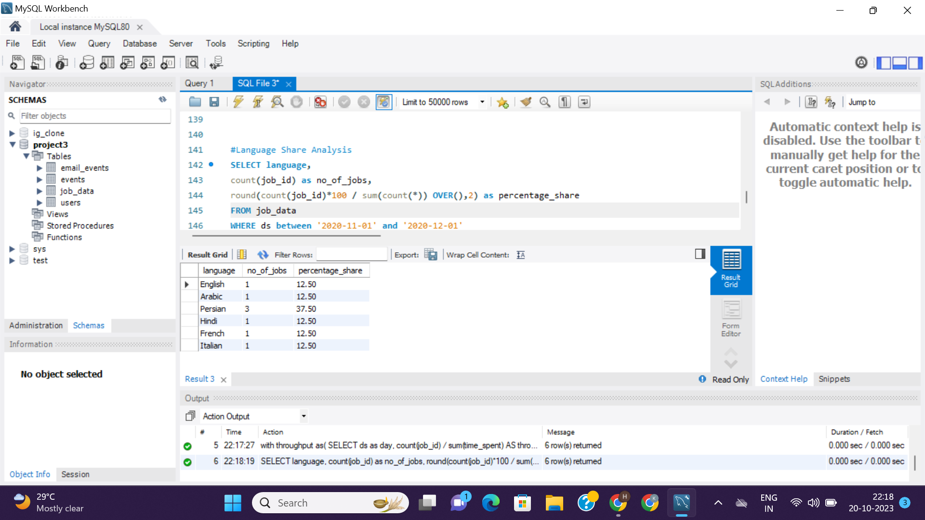
<= Query
Result =>

Slide 12
4. Duplicate Rows Detection : Identify duplicate rows in the data.
Your Task: Write an SQL query to display duplicate rows from the job_data table.

Slide 13
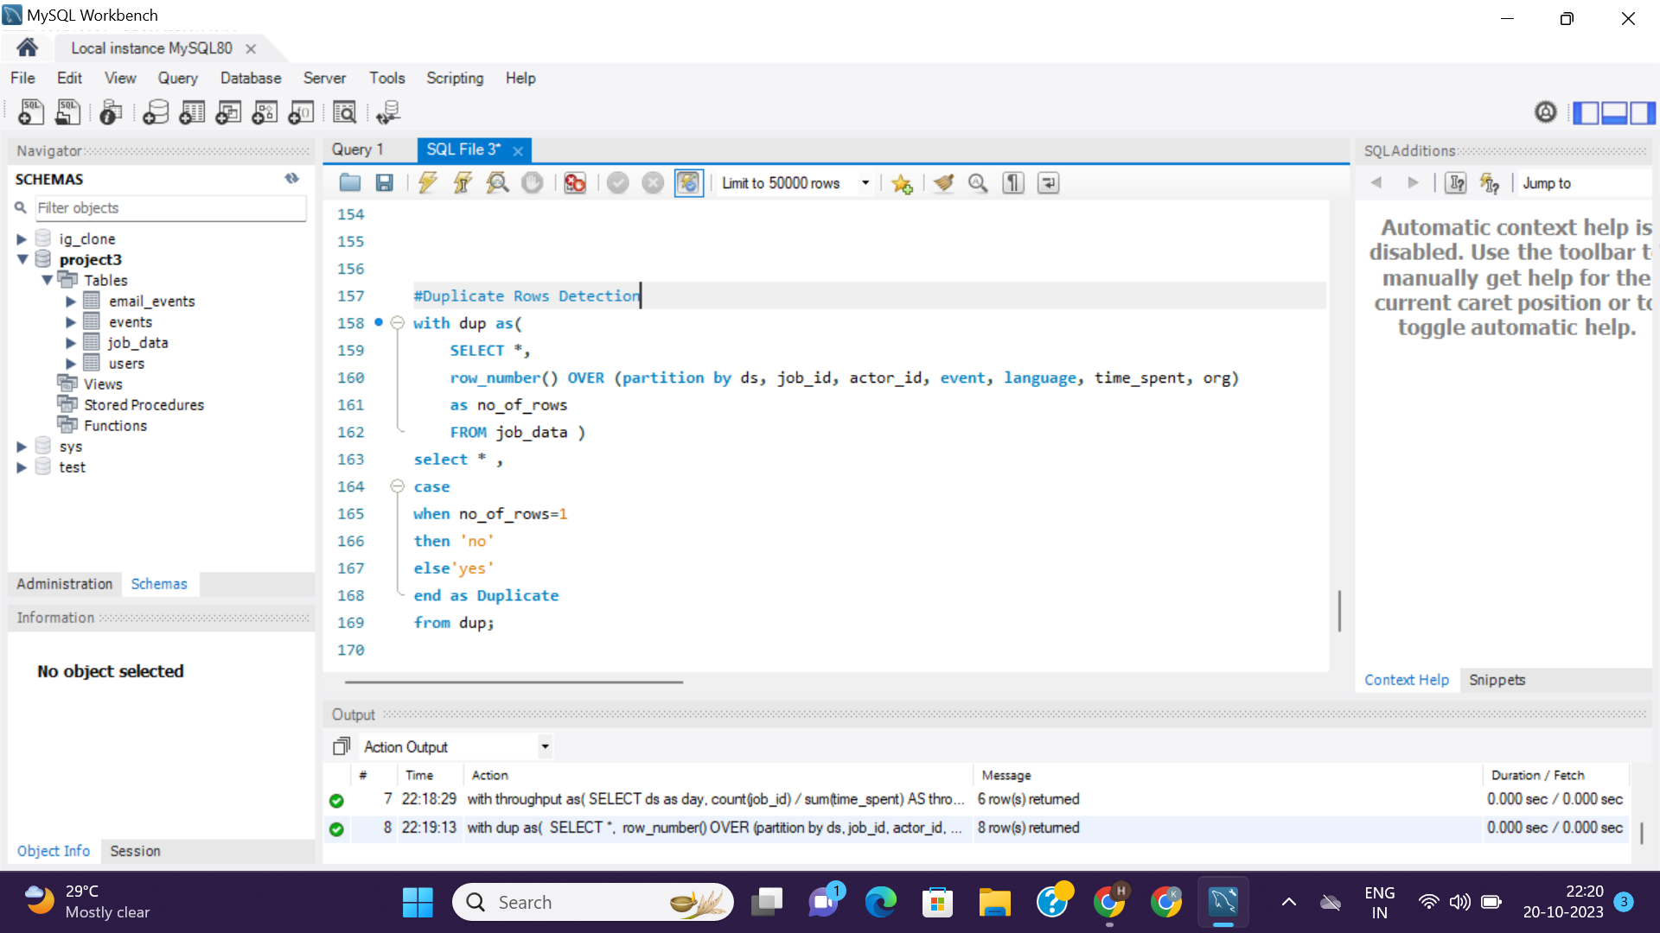
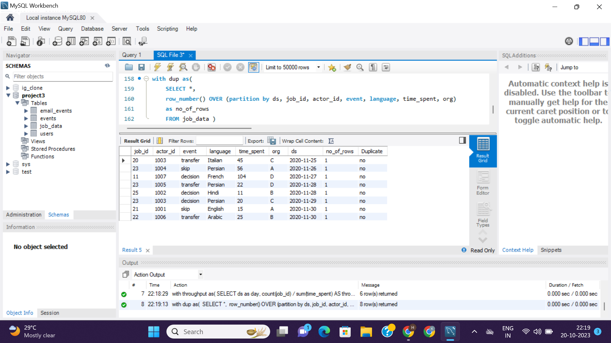
<= Query
Result =>

Slide 14
Case Study - 2: Investigating Metric Spike

Slide 15
1. Weekly User Engagement: Measure the activeness of users on a weekly basis.
Your Task: Write an SQL query to calculate the weekly user engagement.

Slide 16
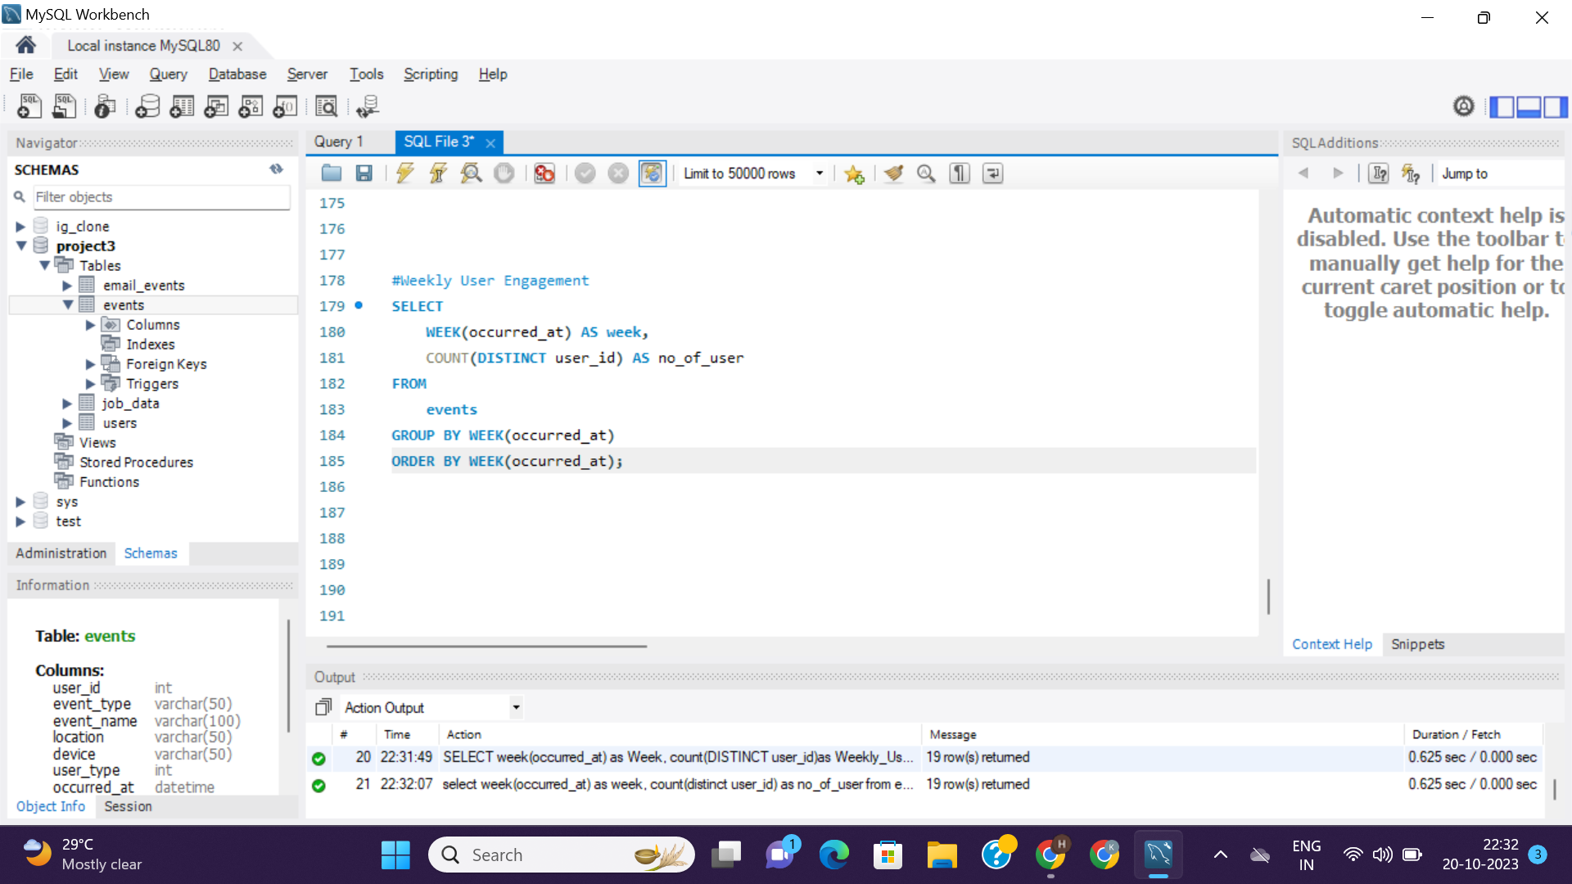
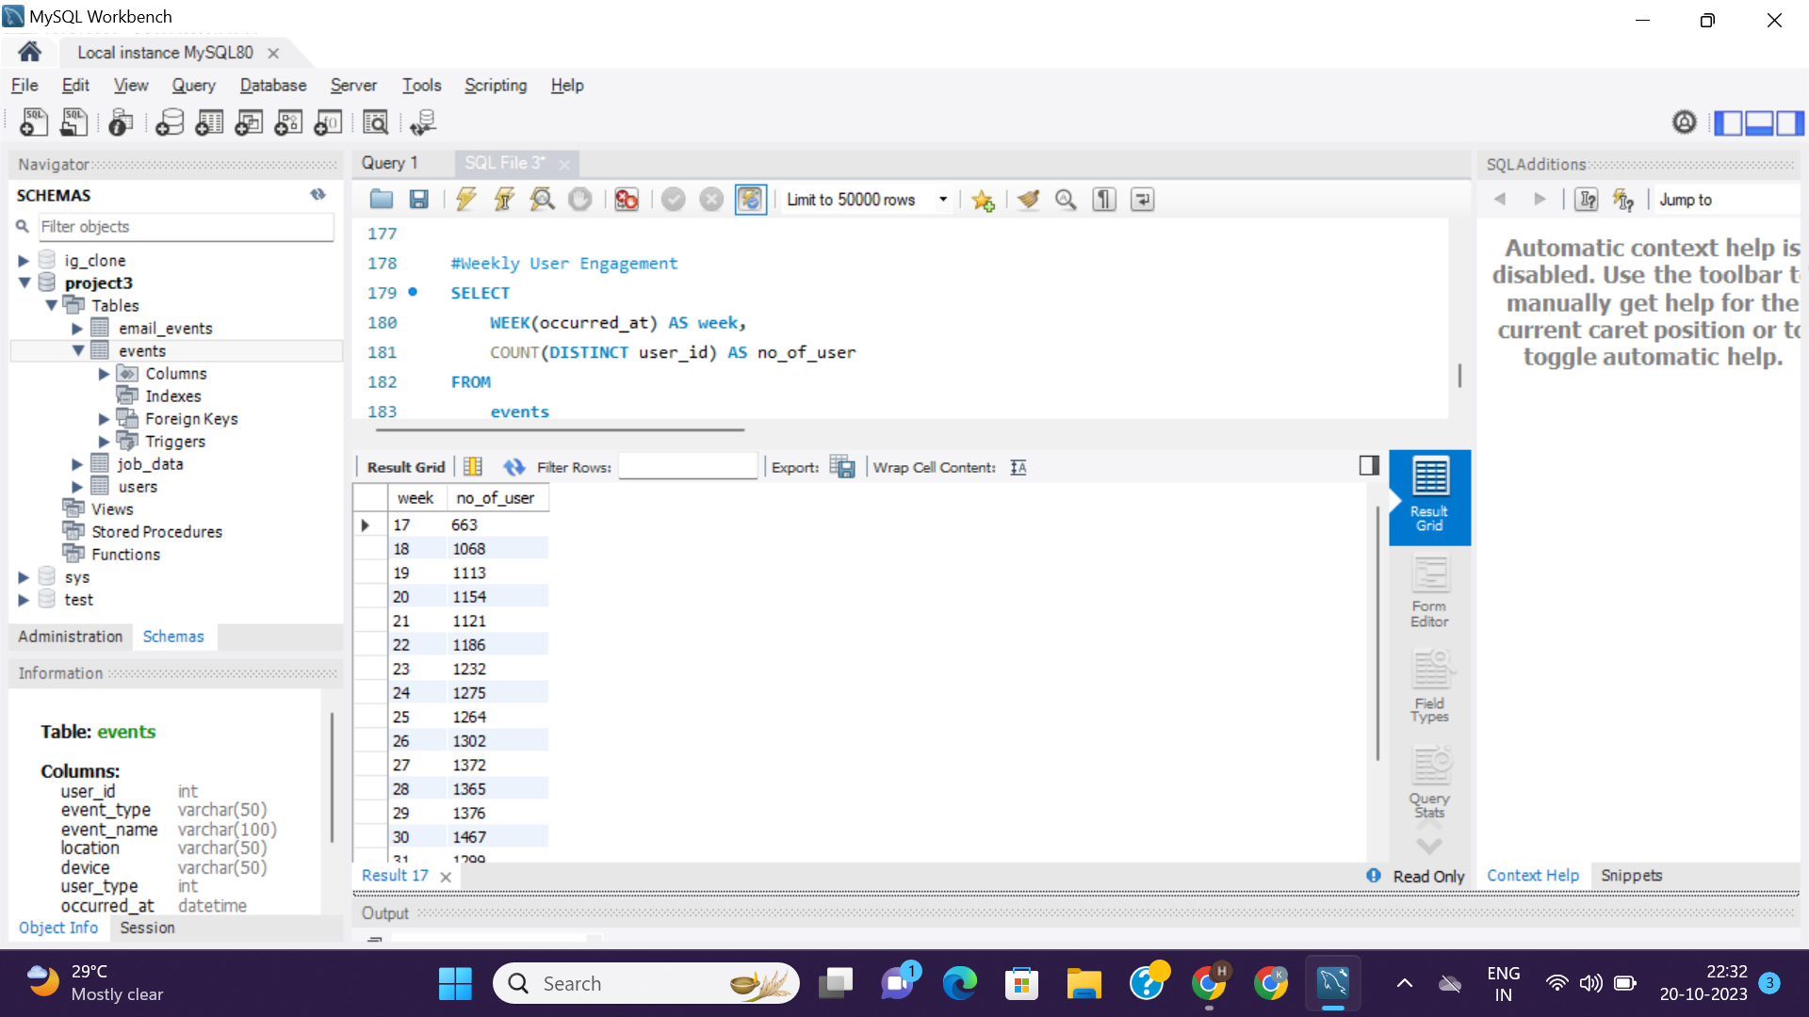
<= Query
Result =>

Slide 17
2. User Growth Analysis: Analyze the growth of users over time for a product.
Your Task: Write an SQL query to calculate the user growth for the product.

Slide 18
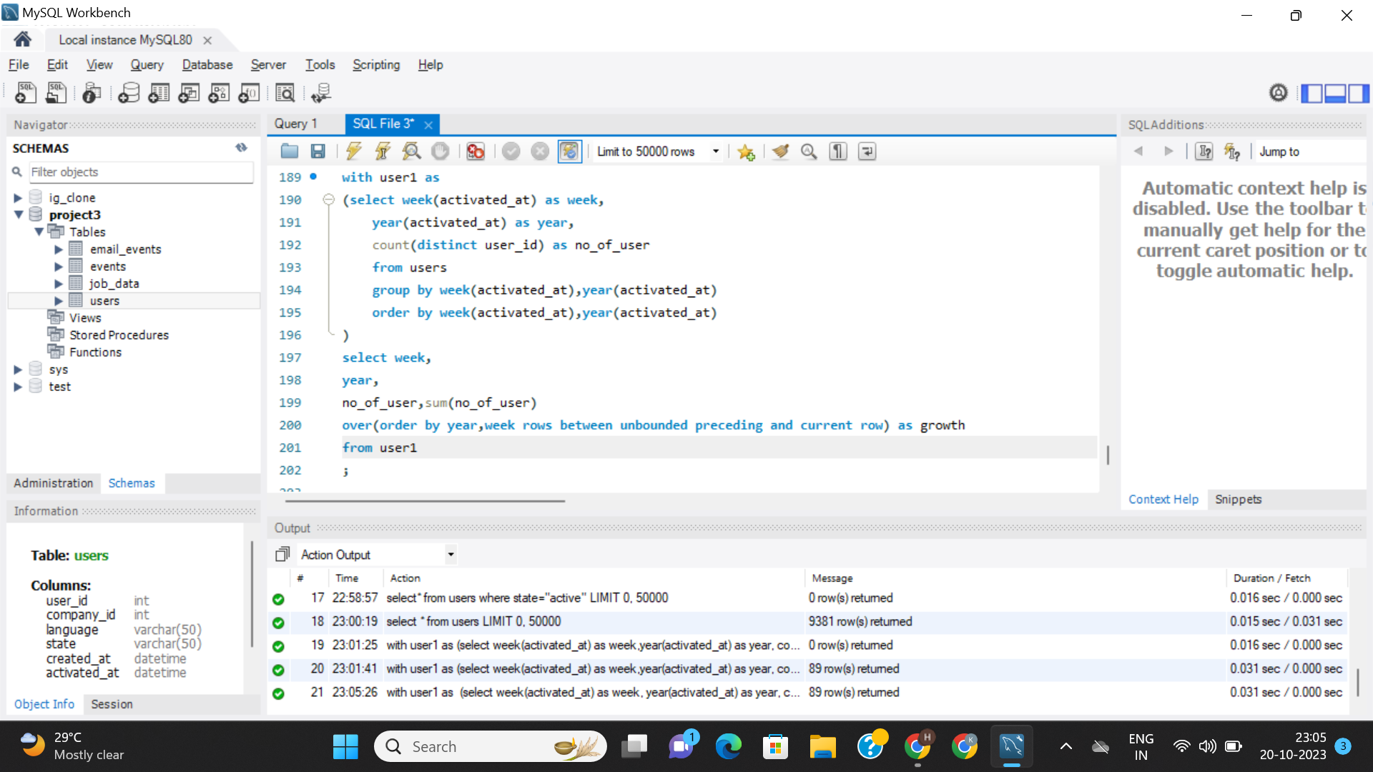
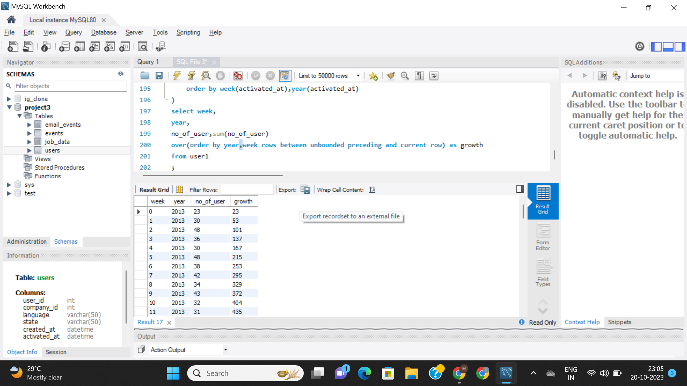
<= Query
Result =>

Slide 19
3. Weekly Retention Analysis: Analyze the retention of users on a weekly basis after signing up for a product.
Your Task: Write an SQL query to calculate the weekly retention of users based on their sign-up cohort.

Slide 20
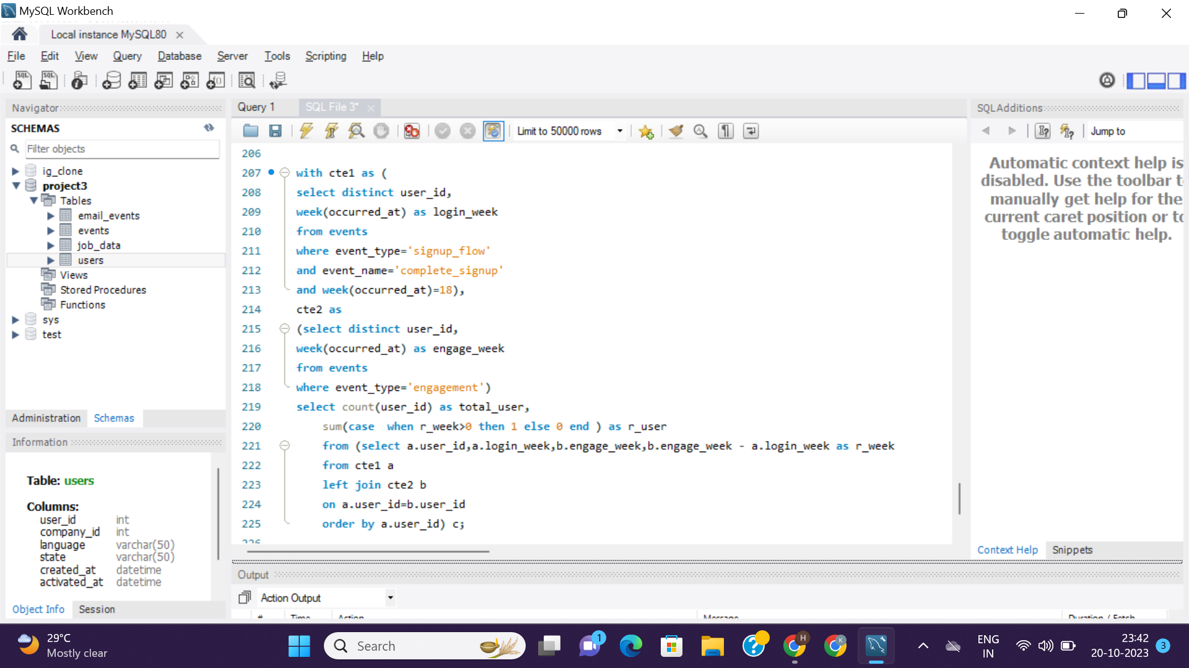
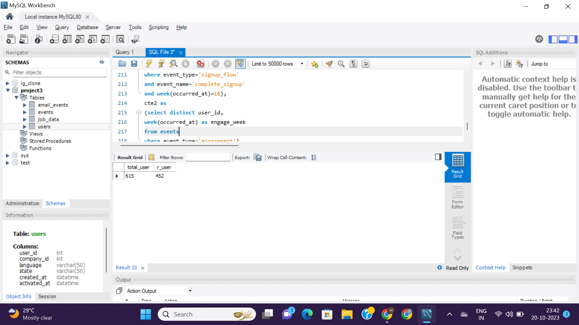
<= Query
Result =>

Slide 21
4. Weekly Engagement Per Device: Measure the activeness of users on a weekly basis per device.
Your Task: Write an SQL query to calculate the weekly engagement per device.

Slide 22
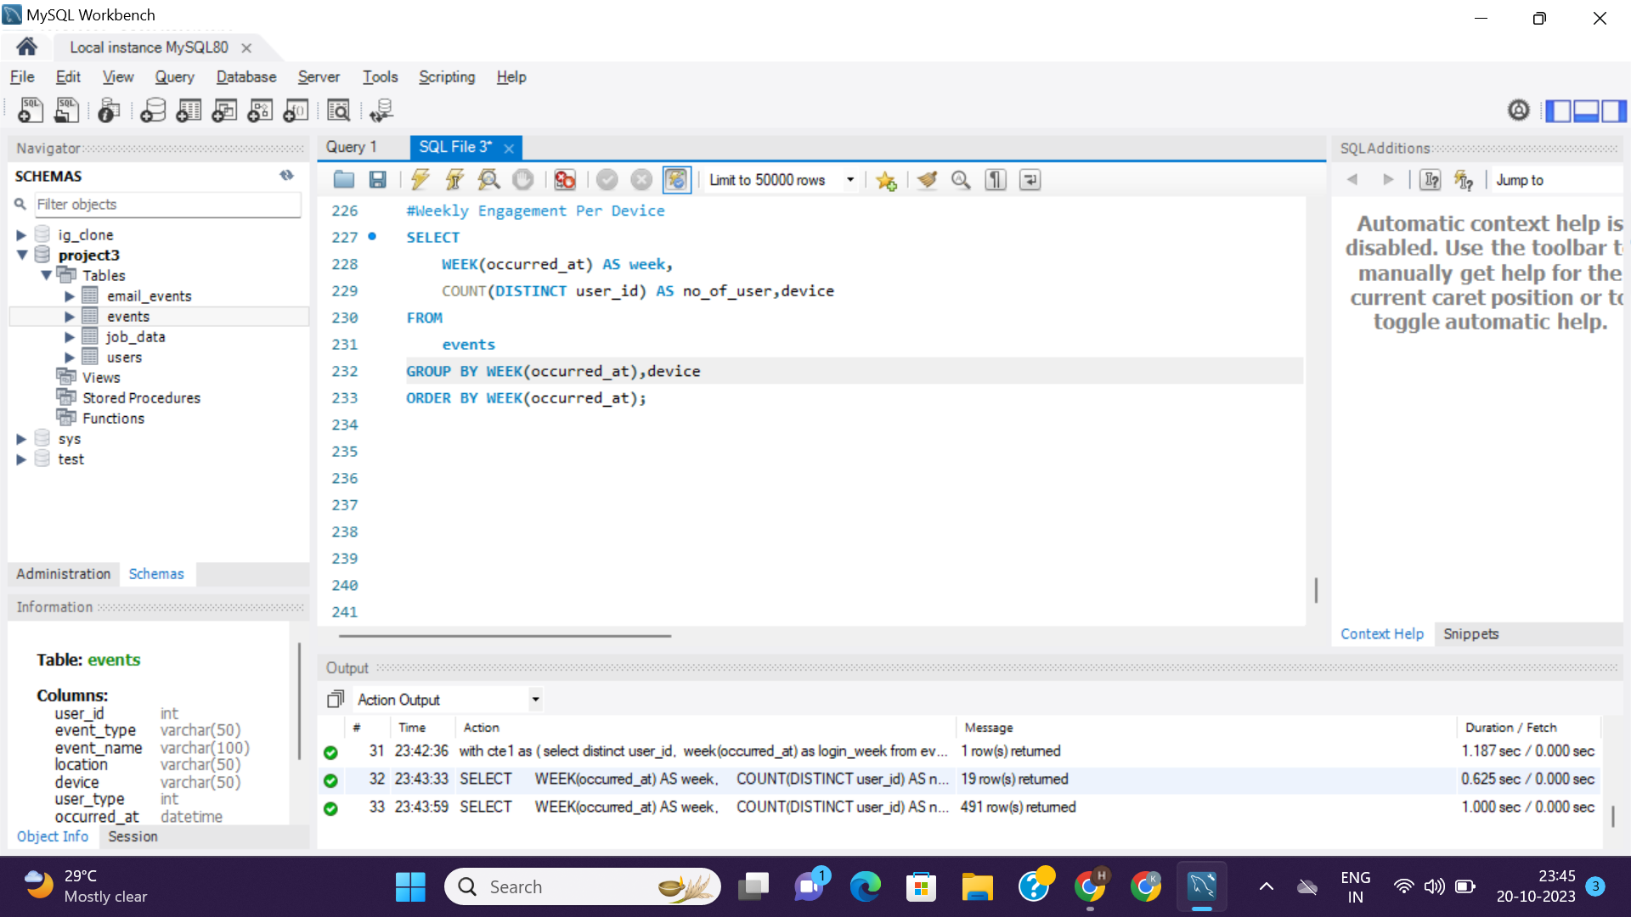
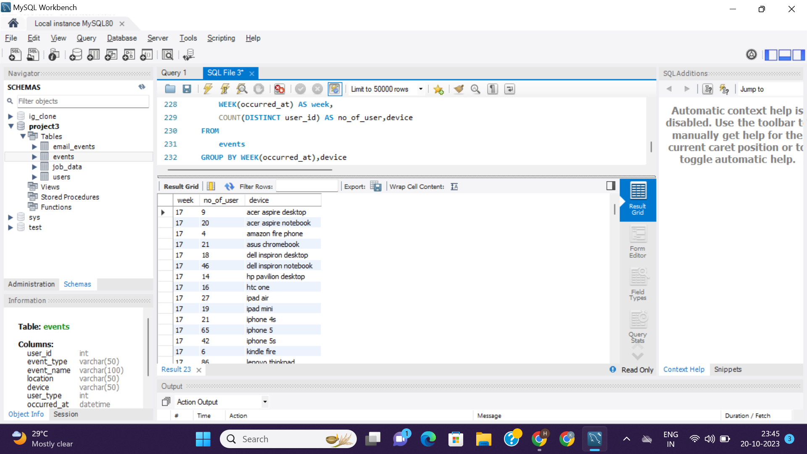
<= Query
Result =>

Slide 23
5. Email Engagement Analysis: Analyze how users are engaging with the email service.
Your Task: Write an SQL query to calculate the email engagement metrics.

Slide 24
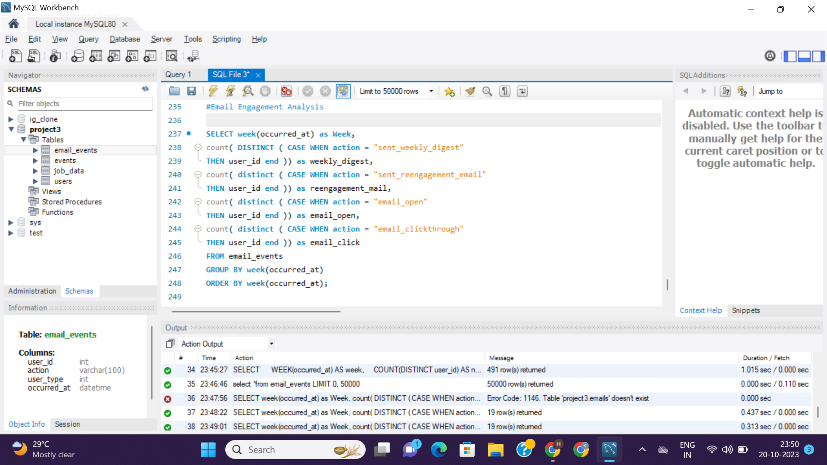
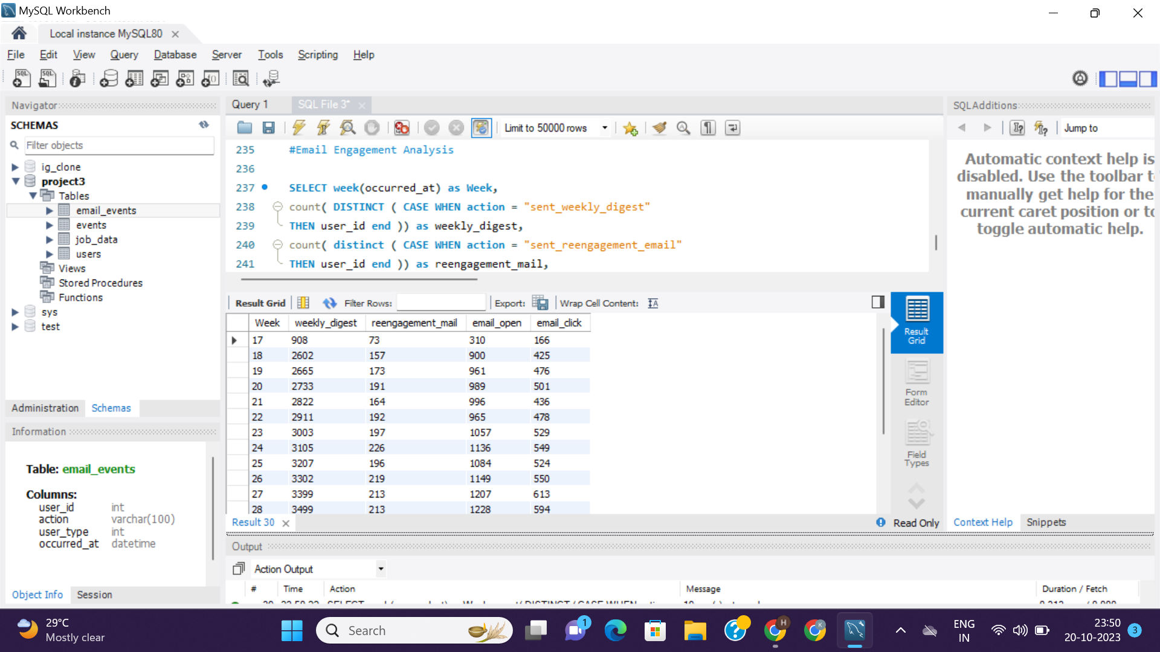
<= Query
Result =>

Slide 25
Insights & Results :-
No. of jobs reviewed per day per hour is very less.
7-day rolling average is best for throughput.
The rows which have ‘yes’ value in duplicate columns are duplicate rows else if ‘no’ is there then there are no duplicates.
Weekly user engagement is highest in 30th week.
Persian language is most popular.
Most of the users are using macbook pro.
By growth insights we can see that users increasing rate has almost 30-40 add-ons each week.

Slide 26
Thank You

